Slide 1
Practice Lab:
This Practice Lab is dependent on Discussion Module 7453, where most of the objects we create in this lab were introduced.
This Practice Lab requires a working DSE system, with DSE Search enabled, and with ability to execute CQL DDL.
If running the optional portions of this lab, this Practice Lab requires a ssh(C) prompt on all nodes operating DSE Search. A node reboot is required.
All commands are run from CQLSH, or DSE Studio. CQLSH is required to COPY data into (a table).
DSE Search, Geospatial
Notes:
The goal of this Practice Lab is to create a distance from point; Where’s the closest Starbuck’s ?
Runtime requirements are detailed in the slide above.

Slide 2

Challenge 1: Closest Starbucks, USA
2017; 17,000 Starbucks locations USA
Github downloaded data; 6000 US Starbucks locations, 10 years old ?
Create the runtime to support the query; Where is my closest Starbucks ?
Notes:
Design and deliver the runtime statements and query to deliver the above-
Reference Urls:
https://github.com/mmcloughlin/starbucks

Slide 3
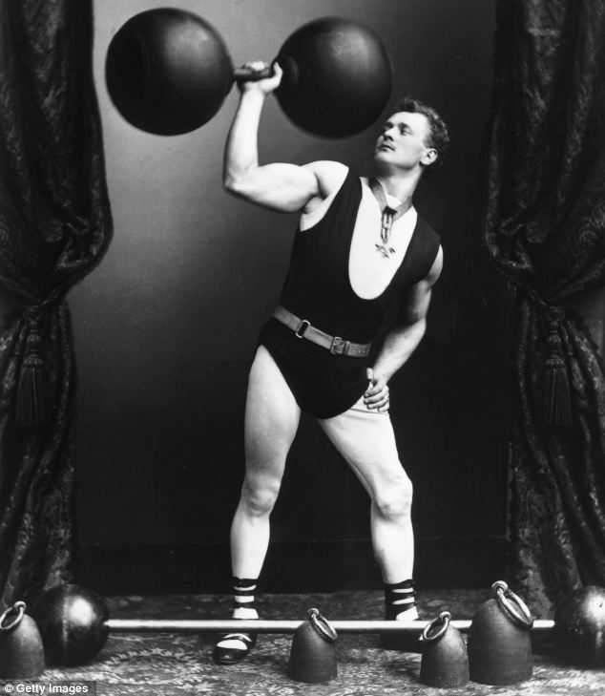
Challenge 1: Create basic runtime, Load Data-
Given file; 7454_my_mapdata.small.csv
CREAT KEYSPACE ...
CREATE TABLE ...
Load data;
COPY my_mapdata
(
md_pk,
...
md_type
)
FROM '7454_my_mapdata.small.csv'
WITH HEADER = TRUE ;
Execute all of the instructions on the notes page below-
Notes:
CQL syntax to harvest from:
DROP KEYSPACE IF EXISTS ks_7454;
CREATE KEYSPACE ks_7454 WITH REPLICATION =
{'class': 'SimpleStrategy',
'replication_factor': 1};
USE ks_7454;
CREATE TABLE my_mapData
(
md_pk TEXT,
md_latLng TEXT,
md_lat TEXT,
md_lng TEXT,
md_name TEXT,
md_address TEXT,
md_city TEXT,
md_province TEXT,
md_postcode TEXT,
md_country TEXT,
md_phone TEXT,
md_category TEXT,
md_subCategory TEXT,
md_type TEXT,
md_tags TEXT,
md_mySource TEXT,
PRIMARY KEY (md_pk)
);
COPY my_mapdata
(
md_pk,
md_address,
md_category,
md_city,
md_country,
md_lat,
md_latlng,
md_lng,
md_mysource,
md_name,
md_phone,
md_postcode,
md_province ,
md_subcategory,
md_tags,
md_type
)
FROM '7454_my_mapdata.small.csv'
WITH HEADER = TRUE ;

Slide 4
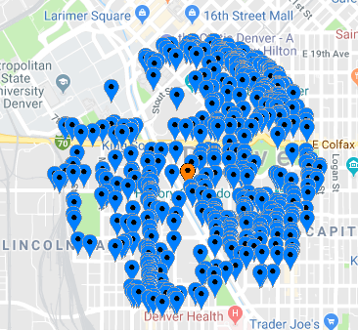
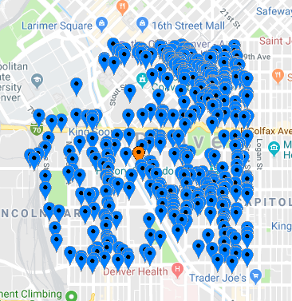
Challenge 1: The Query-
Use LatLonType
Write the (Radius from point), geofilt query-
Write the bbox query-

Slide 5
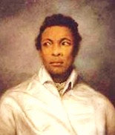
Go Farther: (Optional)
A navigator and explorer of African ancestry, Pedro Alonso Nino traveled with Christopher Columbus’ first expedition to the New World in 1492. Pedro Nino was the pilot of Columbus’ ship the “Santa Maria.”
http://legacysunfoldingjourney.blogspot.com/2013/07/african-explorers-and-settlers-of-new.html
Notes:
Go farther in this Practice Lab: given sample syntax, build something new.

Slide 6
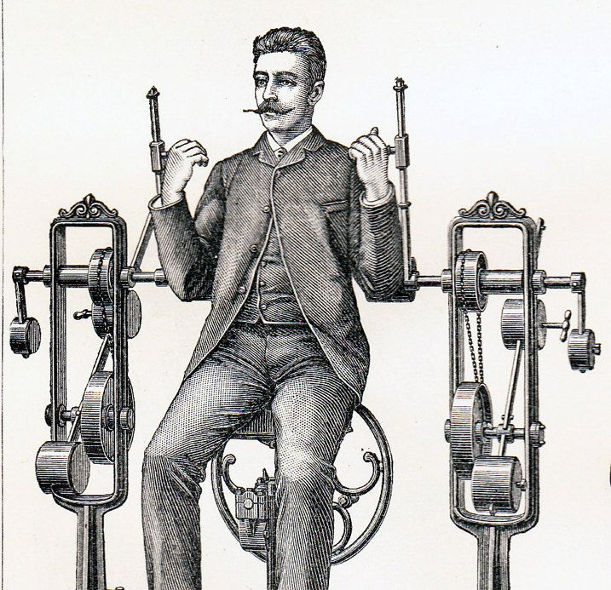
Challenge 2 (Optional): Add polygon support-
Extend (Copy) Challenge 1-
Download JTS from, http://central.maven.org/maven2/com/vividsolutions/jts/1.13/DSE
Copy Jar into, ./resources/solr/lib (from parent directory of DSE).
Restart DSE
Add a polygon query; Intersects/POLYGON
Use, SpatialRecursivePrefixTreeFieldType
To save time, you can do all of this work on new tables, etcetera.
Notes:
Apply to the goals outlined above.
Download and install JTS, restart DSE.
Design and deliver an Intersects/POLYGON query.

Slide 7

Practice Lab:
Lessons learned
Notes:
Discuss what worked well, poorly, from the Practice Lab.

Slide 8
End of Module:
Notes:
End of Practice Lab-

